Slide 1
Intro to CV: PyTorch and MLP
Presented by Alan, Stephanie, and Weiji

Slide 3
Overview Computer Vision & MNIST
General (Supervised) Machine Learning Problems How do we formulate and approach a machine learning problem?
Introduction to PyTorch Tensors, Gradients, Autograd, Linear Algebra
Multilayer Perceptron Applying what we’ve learned

Slide 4
Interactive Notebook
Make a copy https://acmurl.com/cv1-interactive

Slide 5
Overview
Introduction to Computer Vision and MNIST

Slide 6
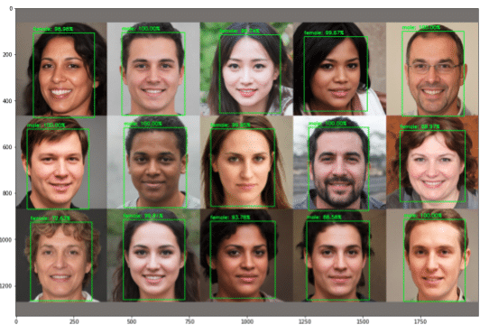
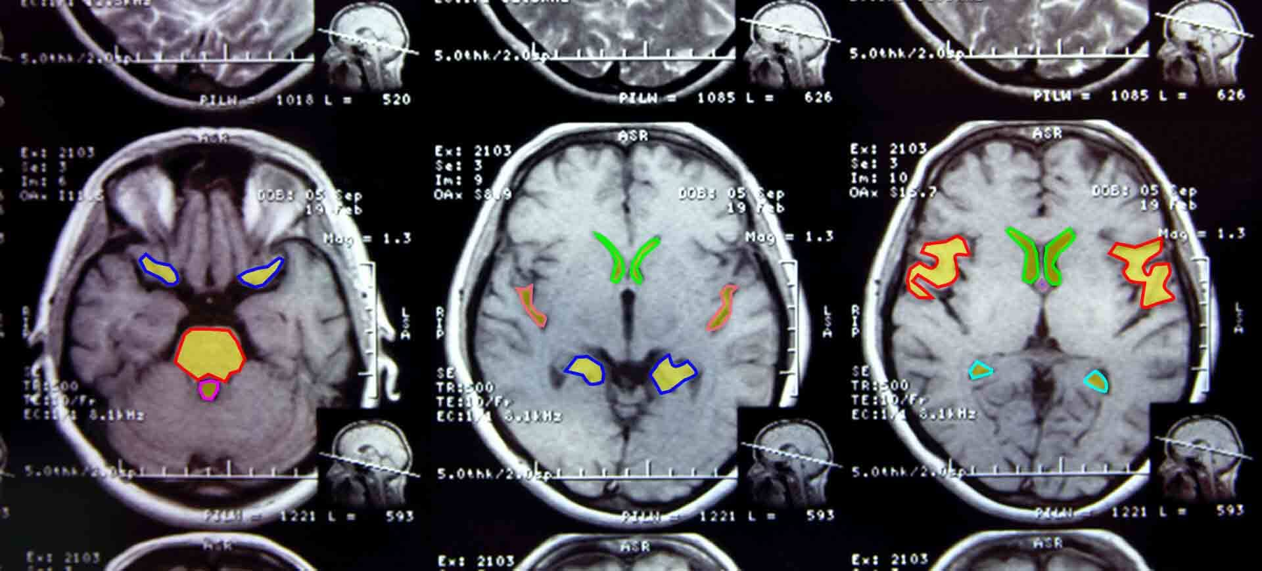
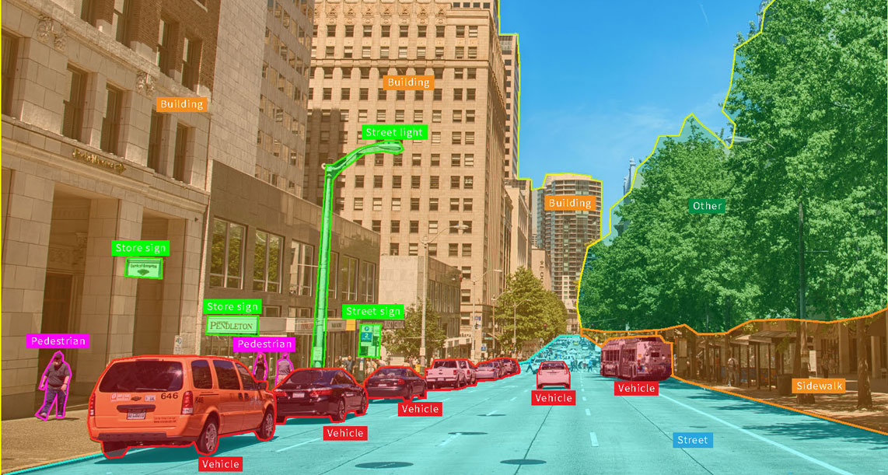
What is Computer Vision?
Definition:
Computer Vision is a field of AI that enables computers and systems to derive meaningful information from digital images, vidoes, and other visual inputs - and take actions or make recommendations based on that information.
Applications:
Autonomous Vehicles
Facial Recognition
Medical Imaging
Virtual Reality
Security
Robotics
Today, we’re talking about the tools (PyTorch) needed for CV and building towards Neural Networks (the foundations of CV)

Slide 7
General ML Problems
Formulating a (supervised) ML problem

Slide 8
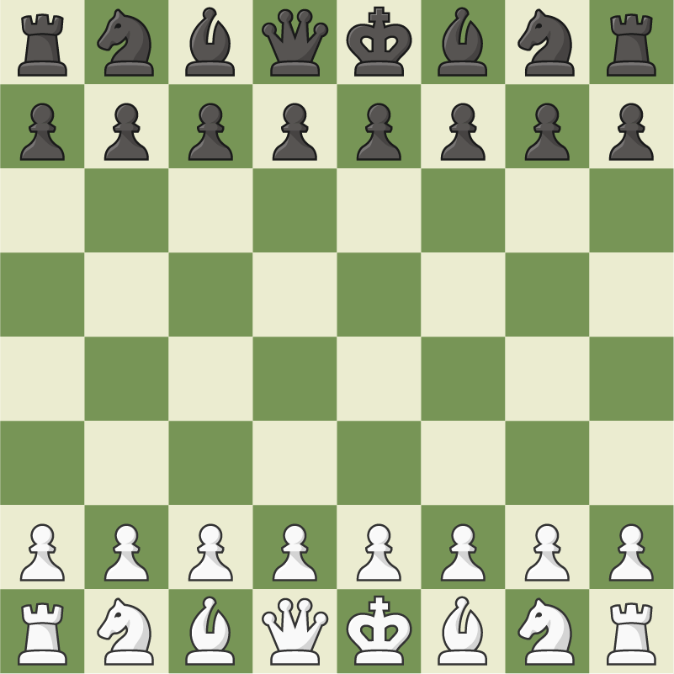
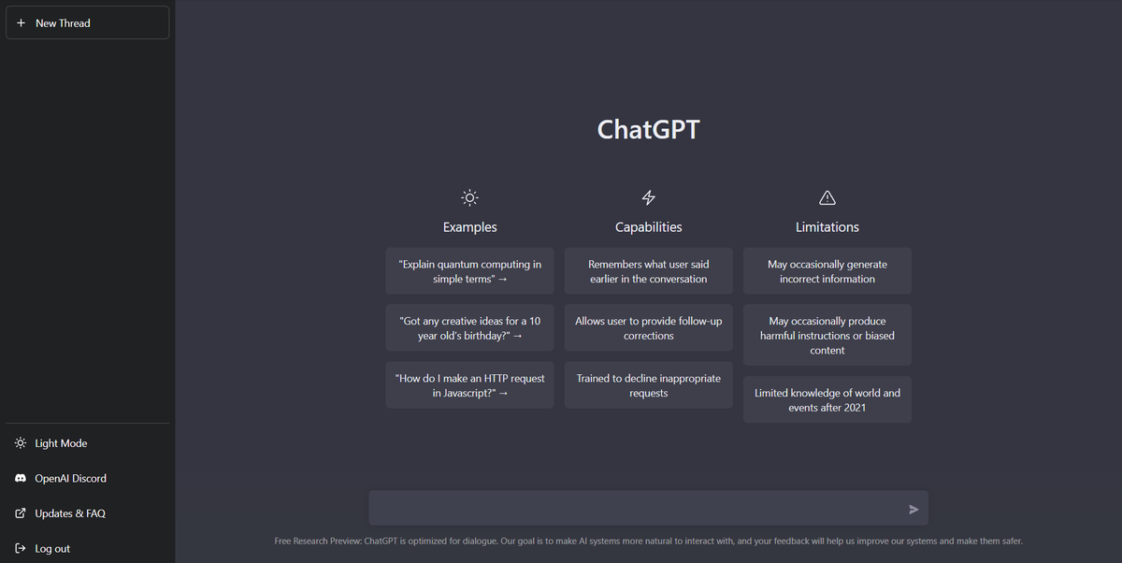
General Machine Learning Problems
In general, ML can be applied to many different situations, and their formulations are broad and varied
From decision-making (such as in playing chess) to holding conversations (chatbots)

Slide 9
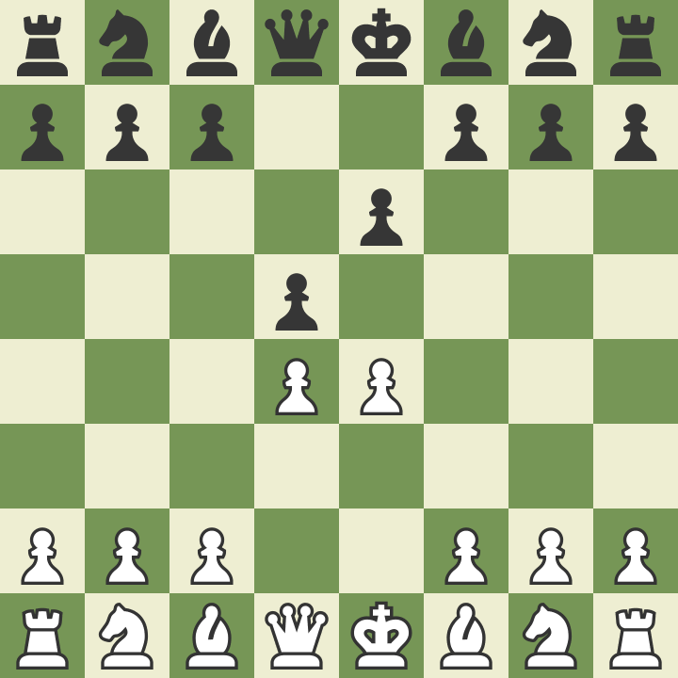
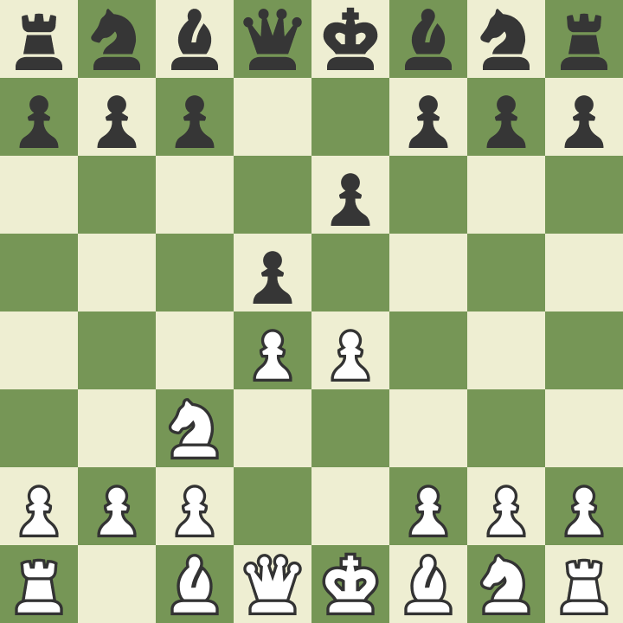
At the core it’s about designing a function mapping input to a desired output.
ML Model
Notes:
Examples: modeling physical phenomena, approximating functions

Slide 10
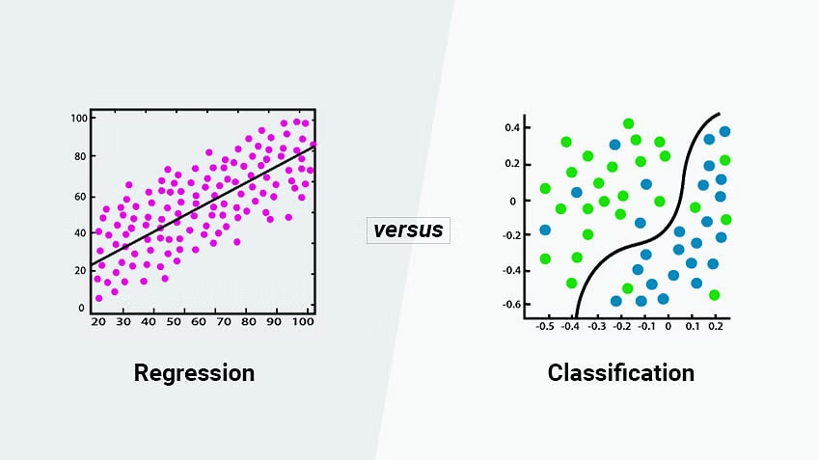
Basic Formulations: Regression vs Classification
Machine Learning
Using data to train a model to make predictions
Mathematically, this core process of predictive modeling is called function approximation
Approximating a mapping function (f) from input variables (x) to output variables (y)
The mapping function predicts the category/labels for a given observation.
The biggest difference between regression and classification is regression outputs a continuous variable while classification outputs a discrete variable
Regression
Ex. Predicting the price a house will set for
Predicts a continuous quantity
Classification
Ex. Email being classified as ‘spam’ or ‘not spam’
Predicts a discrete class label

Slide 11
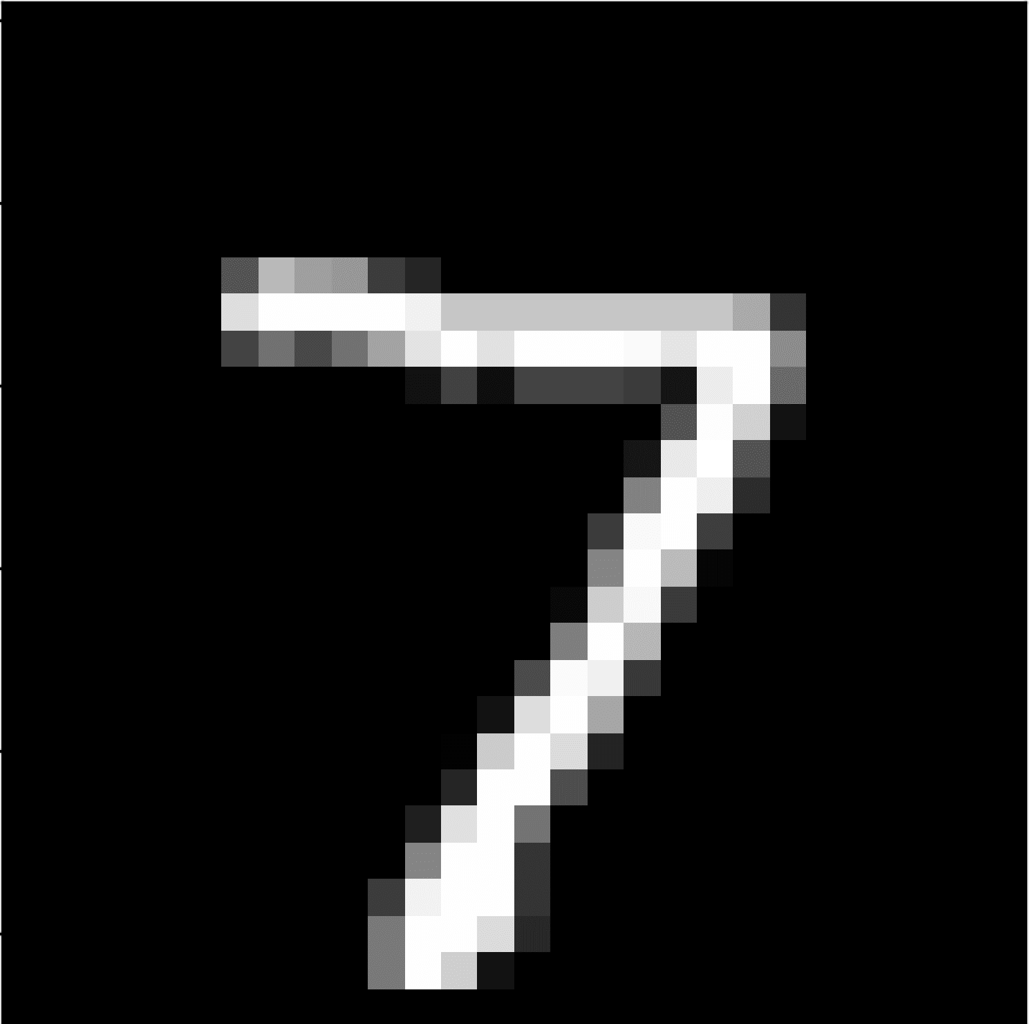
7
ML Model
Notes:
Examples: modeling physical phenomena, approximating functions

Slide 12
7
ML Model
28x28
10 possible labels
Notes:
Examples: modeling physical phenomena, approximating functions

Slide 13
7
ML Model
784 x 1
10 possible labels
Notes:
Fill in with notebook screenshots

Slide 14
7
Notes:
Fill in with notebook screenshots

Slide 15
Intro to Pytorch
Tensors, Gradients, Autograd, Linear Algebra

Slide 16
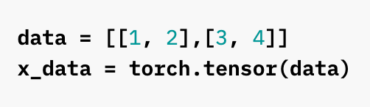
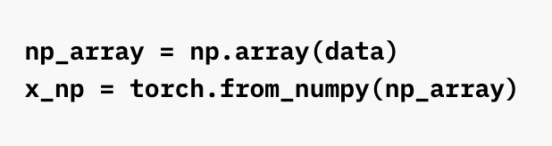
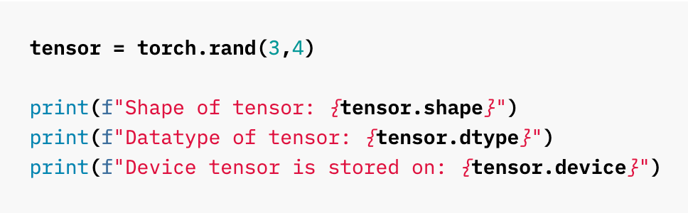
Introduction to PyTorch - Tensors
Tensors
A data structure (equivalent to a multidimensional array i.e. matrix) to store numeric values.
Default data structure for neural networks
Tensor attributes
torch.dtype - species type of data in tensors
torch.device - specifies where tensor computations are performed, either CPU or GPU
torch.layout - species how tensors are stored in memory
Tensor Operations
There’s 100s of operations including arithmetic, linear algebra, matrix manipulation, etc.
Similar to NumPy
CPU v. GPU
Default, tensors are ran on the CPU. You can switch to GPU for faster processing (but it’s more taxing on the memory for larger tensors)

Slide 17
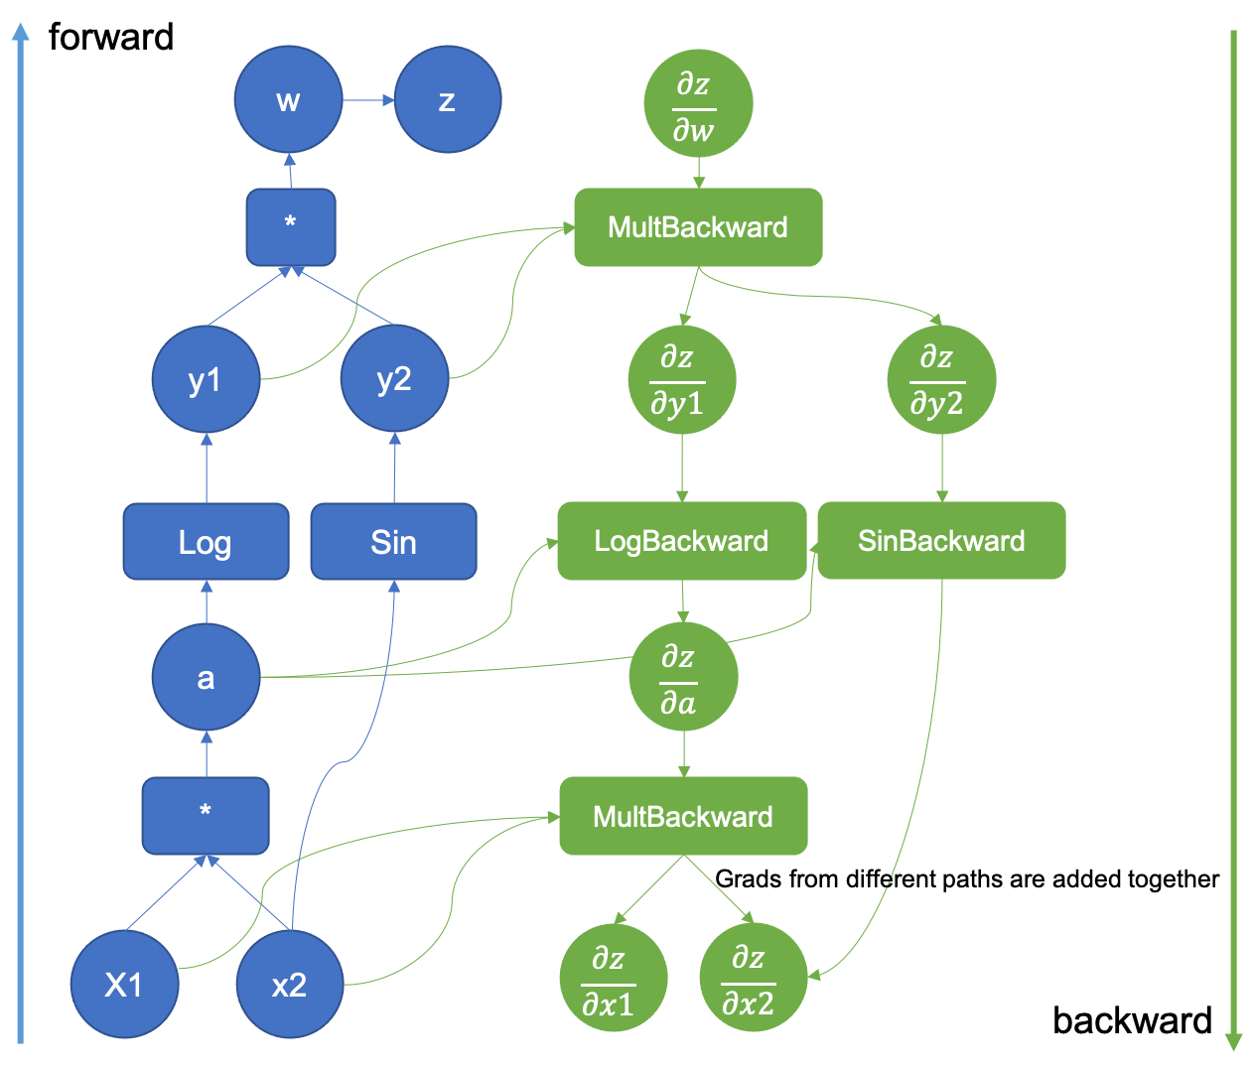
Introduction to PyTorch - Gradients and Autograd
Neural Network Training
Composed of 5 essential steps: defining architecture, forward propagation, calculating loss, backward propagation, and updating weights using learning rate
Gradients and Autograd are essential to backward propagation
Gradients
Used to find the derivatives of the function
Used to update the weight using a learning rate to reduce the loss and train the neural network.
Autograd
torch.autograd
a differentiation engine (calculates derivatives, specifically vector-Jacobian product) that allows for the computation in backpropagation
Simple terms, it computes partial derivatives while applying the chain rule

Slide 18
Neural Networks

Slide 19
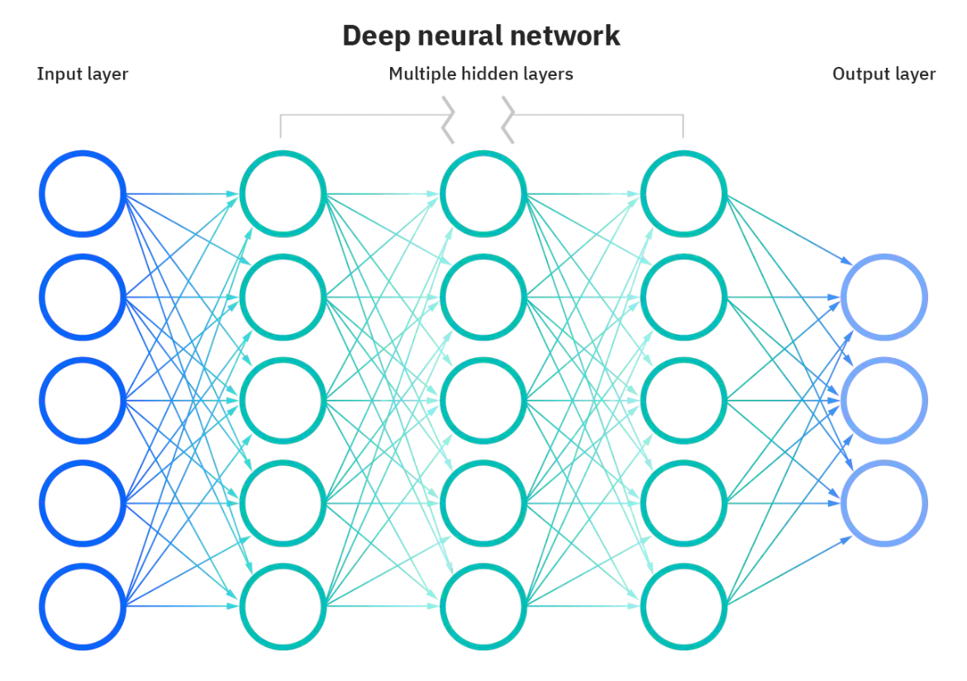
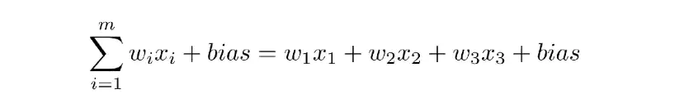
Neural Networks: Definition
Definition
Mimics the brain through a set of algorithms
A neural network is comprised of 4 main components: inputs, weights, a bias, and output
Expressive nonlinear function approximators
Given an arbitrary number of “neurons”, neural networks can approximate any function
Introduce nonlinearities through activation functions
Deep Learning: a subset of ML techniques based on multiple layers of neural networks form

Slide 20

How can we get computers to identify objects in images?

Slide 21

How can we get computers to identify objects in images?

Slide 22
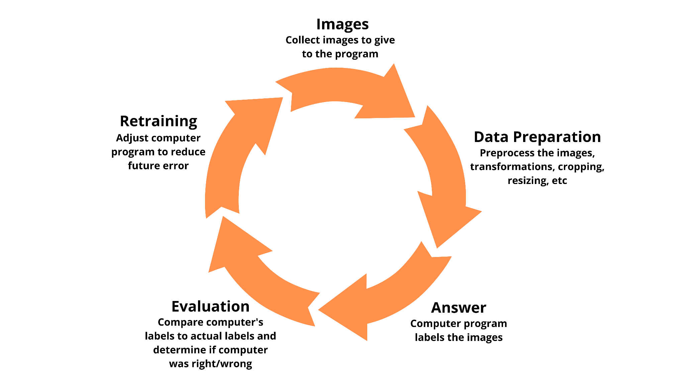
The Idea
Notes:
Cyclical graphic depicting how ML models are trained: Image -> Computer Program -> Answer -> Evaluate how wrong answer is -> Adjust computer program to reduce error

Slide 23
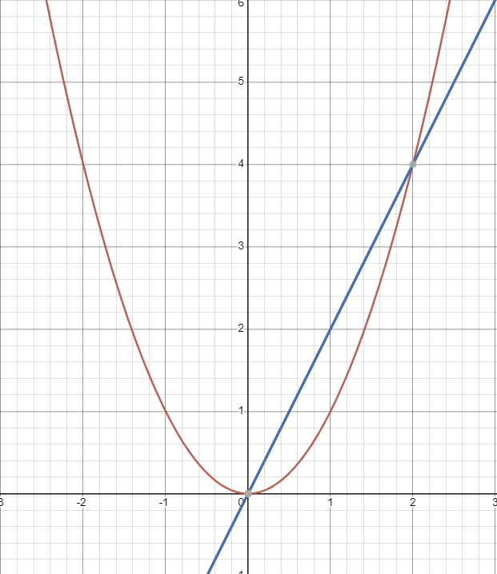
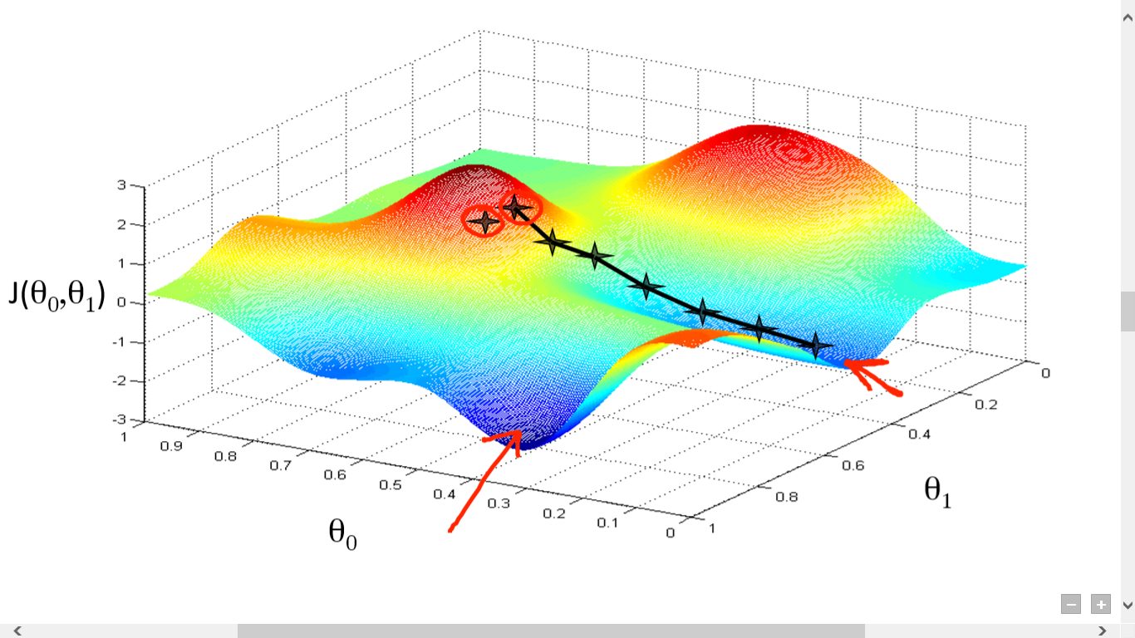
Gradient Descent
Model how wrong our neural network is as a differentiable function
Gradient - multidimensional idea of derivative
Direction of furthest increase: negative gradient is direction of furthest decrease
We map out the loss as a function of our neural network weights, and adjust weights to decrease error, or “loss”

Slide 24
Loss Functions
We need a method of evaluating how correct/wrong a given answer is
We apply a softmax function to predict probabilities
A method of evaluating how well specific algorithms models the given data
Large loss function = predictions deviate too far from the results
Using optimization functions, loss functions learns to reduce the error in prediction
Categorical Cross Entropy
Measures the difference between 2 probability distributions
In our case, we have 2: the current neural network distribution and the correct one
Also differentiable
Notes:
Fill in with categorical cross entropy function

Slide 25
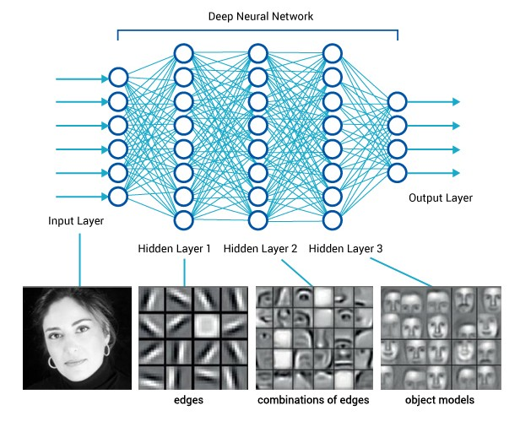
Neural Networks: Computer Vision
Why Neural Networks (Deep Learning) and not classic ML?
Classic ML is more dependent on human intervention to manually determine a hierarchy of features (we need to label the dataset)
Requires structured data
Deep Learning w/neural networks don’t! You can input in an unstructured dataset and have it give you the set of features that distinguish each object (very useful for more complex cases)
Why Neural Networks for Computer Vision
Traditionally,researchers had to train the computer to look for specific features in various images (top down approach).
With a neural network approach, the deep learning algorithms trains itself to analyze the features in the image (bottom up approach)
Thus, instead of having to tell the computer “what should be there,” neural networks allow the computer to identify “what’s there.”

Slide 26
Neural networks are not everything.
Notes:
Examples: modeling physical phenomena, approximating functions

Slide 27
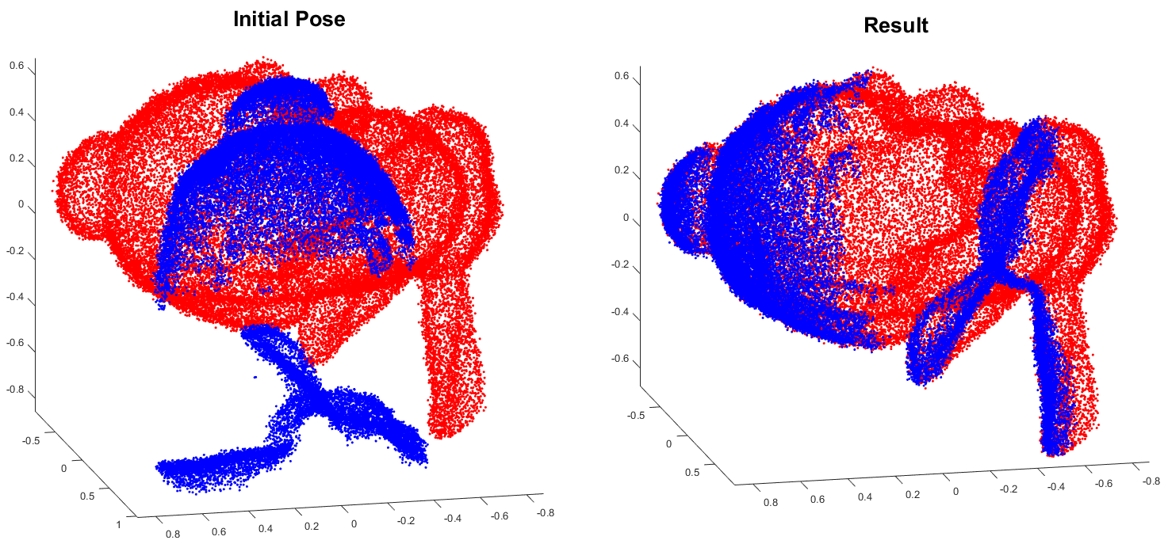
Neural Networks - Intuitions
Neural networks are very popular for recognition tasks in computer vision/all the rage right now
But they’re still lacking in other areas - many 3D computer vision tasks require a mix of classical and deep ML
Neural networks can be used as black boxes but they don’t substitute for intent in approaching a problem
When are neural networks good?
Essentially a nearest neighbors in the feature space
Good for dimension reduction
When euclidean distance represents semantic similarity

Slide 28
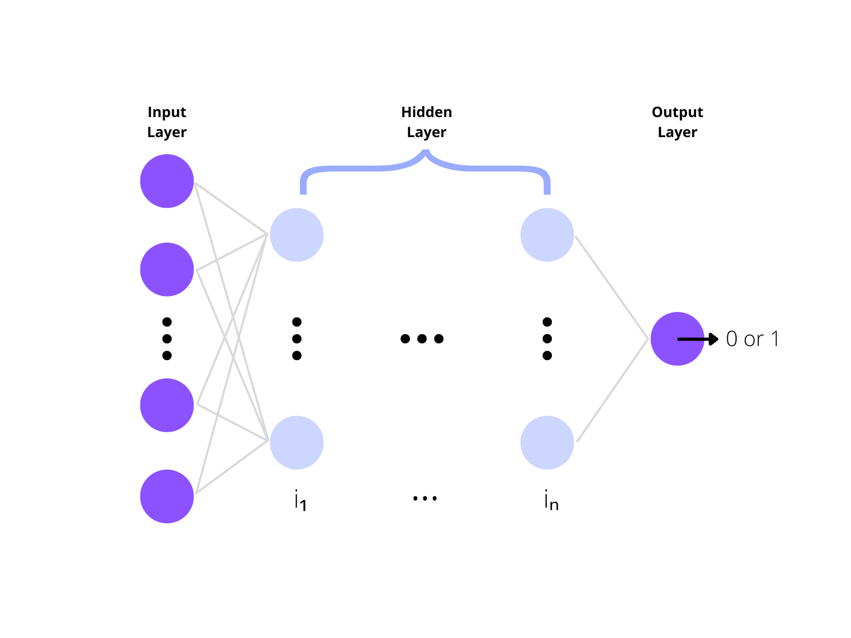
Multilayer Perceptron
Definition
A fully connected class of feedforward neural networks
Neural networks with at least three layers
These three layers are input layer, hidden layer, and output layer
Let’s learn how to make one!

Slide 29
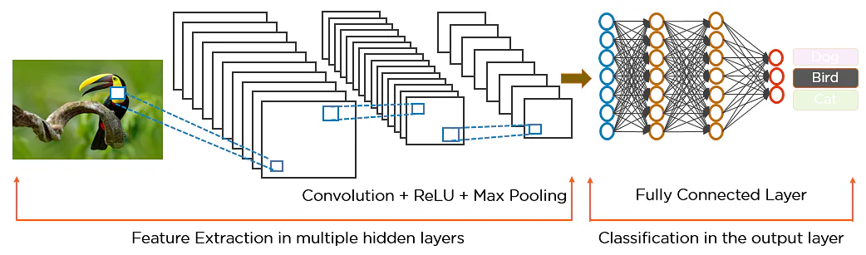
Neural Networks and CNN: Brief Overview
Neural Network Architectures in Computer Vision
Convolutional Neural Networks (foundation for modern CV).
Gets an image, designates it some weightage based on different objects of the image, and then distinguishes from each other
More on this in Workshop 2!

Slide 30
Resources
All resources available in our GitHub repo https://acmurl.com/cv1-repo
Main Notebook (solutions)
Interactive Notebook (questions)
Recording (when uploaded to YouTube)
Slides (pdf and pptx)

Slide 31

Thanks for attending!
Make sure to check in to get membership points

